Slide 1
Compiler basics
Lecture 01

Slide 2
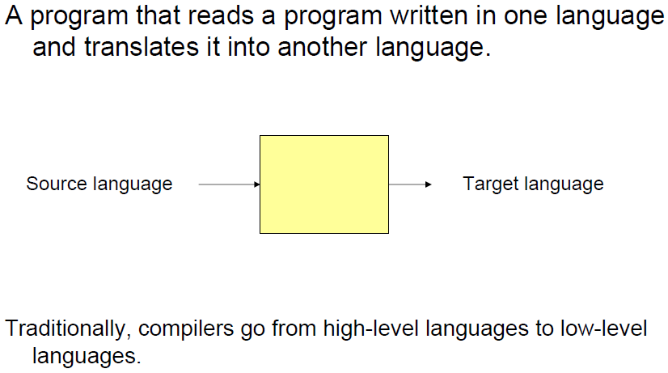
What is a Compiler?

Slide 3
What is a Compiler?
Compilers are the bridges:
- Tools to translate programs written in high-level languages to
efficient executable code.
Another important role of the compiler is to report any errors in the source program that it detects during the translation process.

Slide 4
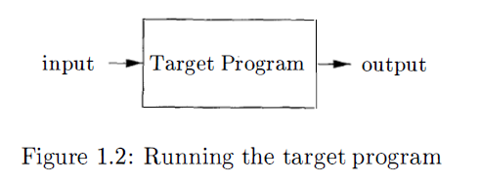

Slide 5
What is an Interpreter?
An interpreter requires no pre-computation it directly takes the source program and runs the input on it producing the desired output.

Slide 6
Compiler vs Interpreter
Compilers and interpreters do similar jobs, but there are differences: To run a program you've written, it must first be translated into machine code so the computer can read it. This is what compilers and interpreters do.
However, compilers convert the code all at once, save it, then run it; whereas interpreters translate the code one line at a time, as it is run.
Programming language like Python, Ruby use interpreters.
Programming language like C, C++ use compilers.
Java?
Error display?

Slide 7
Language Processing System
Interpreters: discussed before
Preprocessors: A source program may be divided into modules stored in separate files. The task of collecting the source program is sometimes entrusted to a separate program, called a preprocessor. The preprocessor may also expand macros into source language statements
Assemblers: The assembly language is processed by a program called an assembler that produces relocatable machine code as its output.
Linkers: Large programs are often compiled in pieces, so the relocatable machine code may have to be linked together with other relocatable object files and library files into the code that actually runs on the machine. The linker resolves external memory addresses, where the code in one file may refer to a location in another file
Loaders: puts together all of the executable object files into memory for execution.

Slide 8
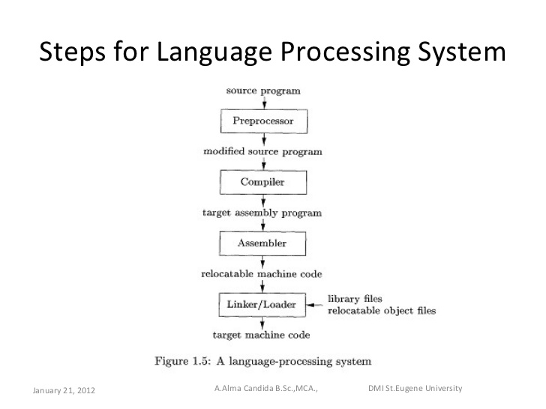

Slide 9
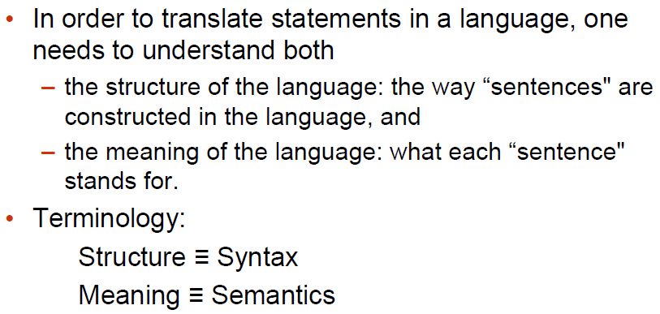
Requirement

Slide 10
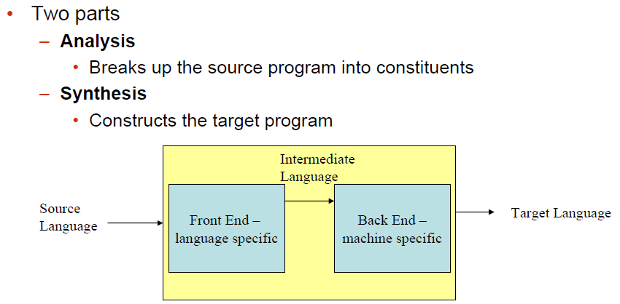
Analysis-Synthesis model of compilation

Slide 11
Phases of Compiler
Lexical Analysis
Syntax Analysis
Semantic Analysis
Intermediate code generation
Code Optimization
Code Generator

Slide 12
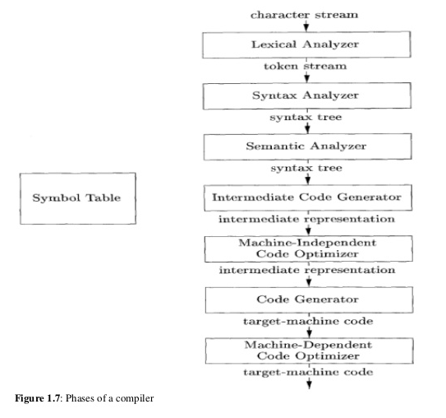

Slide 13
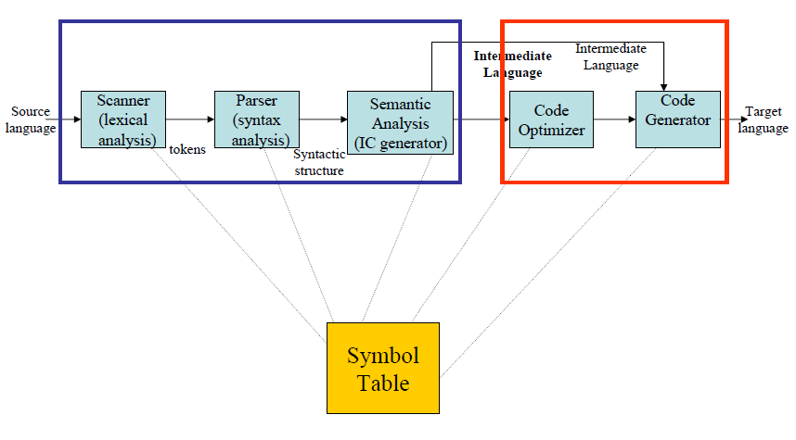
Compilation Steps/Phases

Slide 14
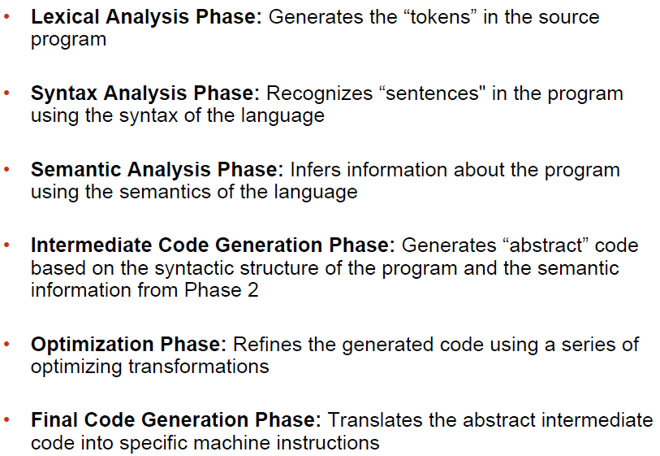
Compilation Steps/Phases

Slide 15
Lexical Analysis
First step: recognize words / lexemes
Smallest unit above letters
This is a sentence
Th isis ase nte nce

Slide 16
Lexical Analysis
Lexical analysis divides program text into or lexemes or “tokens”
if x == y then z = 1; else z = 2;
Tokens are the “words" of the programming language
Lexeme
Meaningful sequences of characters from source character stream

Slide 17
Lexical Analysis
For example
the sequence of characters “static int" is recognized as two tokens, representing the two words “static" and “int"
the sequence of characters “*x++" is recognized as three tokens, representing “*", “x" and “++“
• Removes the white spaces
• Removes the comments

Slide 18
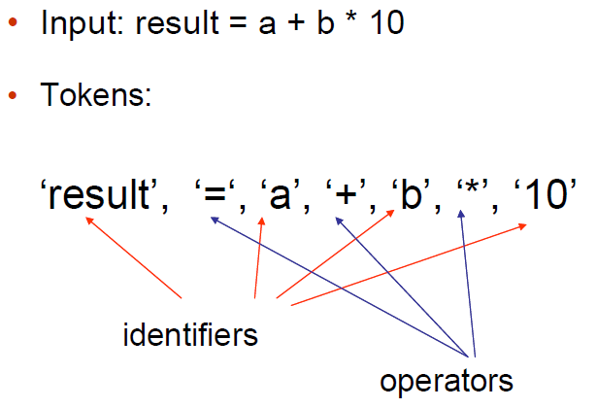
Lexical Analysis

Slide 19
Syntax Analysis (Parsing)
Second Step: Once words are understood, the next step is to understand sentence structure
Creates a tree-like intermediate representation that depicts the grammatical structure of the token stream.
A typical representation is a syntax tree

Slide 20
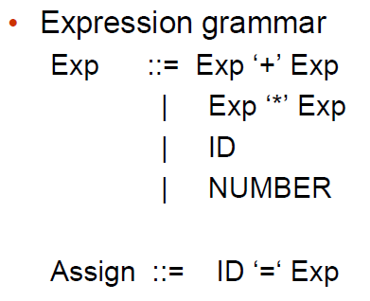
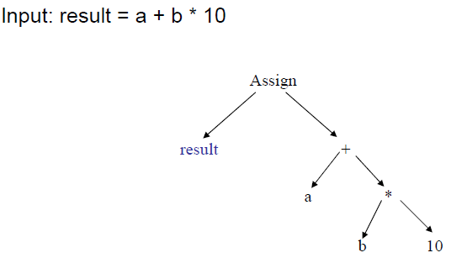
Syntax Analysis (Parsing)

Slide 21
Semantic Analysis
Third Step:
Once sentence structure is understood, we can try to understand “meaning”
This is hard!
Uses the syntax tree and the information in the symbol table to check the source program for semantic consistency with the language definition
Compilers perform limited semantic analysis to catch inconsistencies
Performs type checking
Operator operand compatibility

Slide 22
Code Optimization
Apply a series of transformations to improve the time and space efficiency of the generated code.
Peephole optimizations: generate new instructions by combining/expanding on a small number of consecutive instructions.
Global optimizations: reorder, remove or add instructions to change the structure of generated code
Consumes a significant fraction of the compilation time
Simple optimization techniques can be very valuable

Slide 23
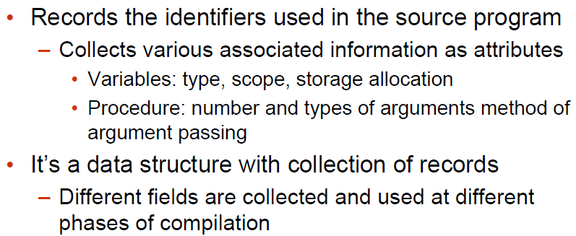
Symbol Table

Slide 24
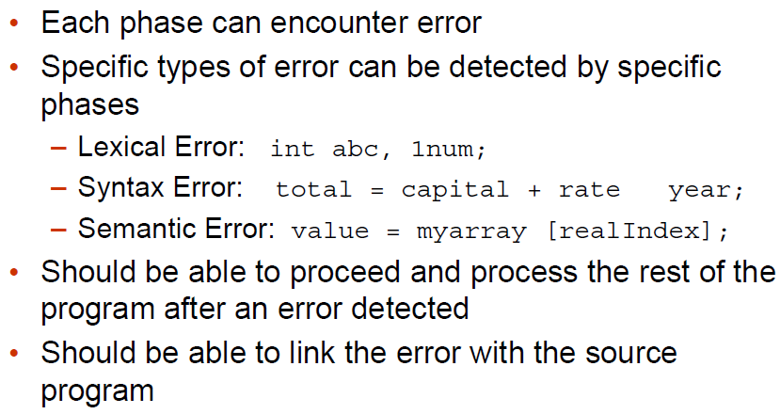
Error Detection, Recovery and Reporting

Slide 25
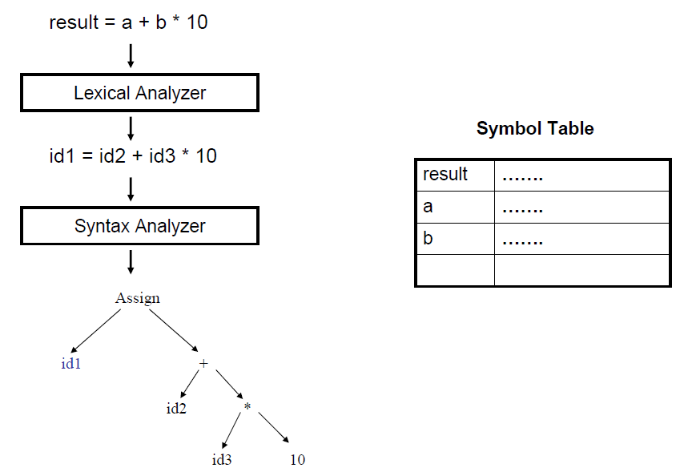

Slide 26
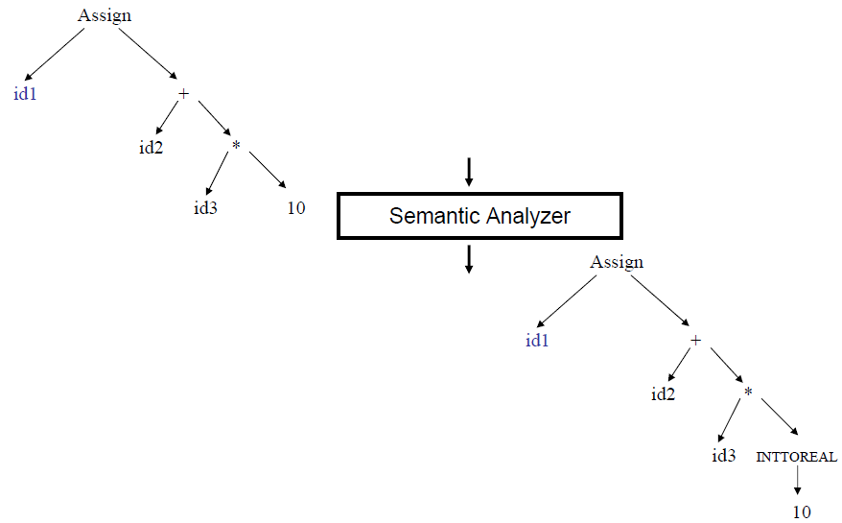

Slide 27
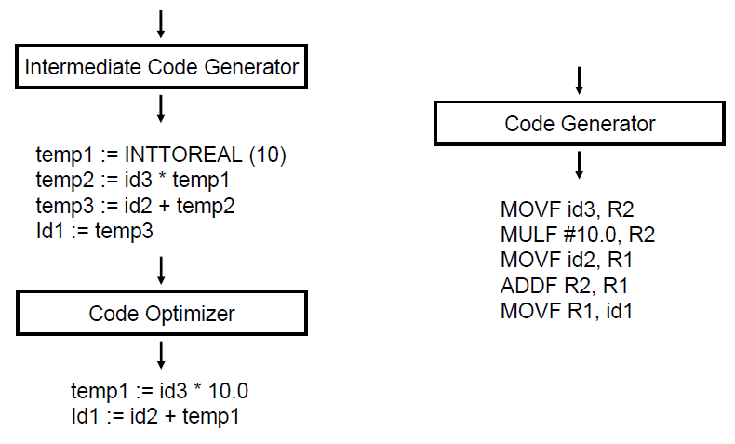

Slide 28
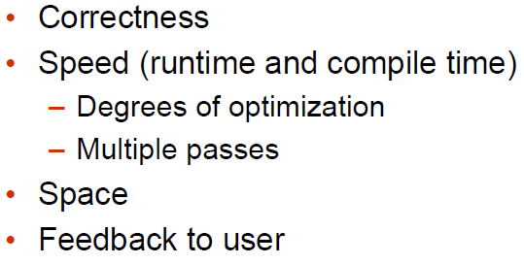
Issues Driving Compiler Design

Slide 29
Other Applications
In addition to the development of a compiler, the techniques used in compiler design can be applicable to many problems in computer science.
Techniques used in a lexical analyzer can be used in text editors, information retrieval system, and pattern recognition programs.
Techniques used in a parser can be used in a query processing system such as SQL.
Many software having a complex front-end may need techniques used in compiler design.
Most of the techniques used in compiler design can be used in Natural Language Processing (NLP) systems

Slide 30
Thank You
Questions?

